Slide 1
NAME : Sakthivel A
Naan Mudhalvan ID: au713921106045
Email iD :sakthivel08022002@gmail.com
Project Title : Environmental Monitoring
Phase-5 : Project Documentation &
Submission

Slide 2
ABSTRACT
Due to vast increase in population, vehicle use, industrialization and urbanization it has resulted in various harmful effects on human wellbeing by directly affecting the health of the people. This project is based on the wireless sensor networks for collecting information about the Environment. In order to monitor, we will develop an IOT Based Environmental Monitoring System, it can monitor various quantities like temperature and humidity over a web server by using the Wi-Fi Technology. In this IOT project, we can monitor the pollution level from anywhere through a dedicated LCU display.

Slide 3
Creating a real-time environmental monitoring system for a park is a comprehensive project that aims to enhance the experience of park visitors while promoting outdoor activities. This system leverages loT devices, a platform for data collection and analysis, and a user-friendly data display to provide valuable information to park-goers. Let's break down the project's components and objectives:
Objectives :
1. Monitor environmental parameters in real-time to ensure visitor safety and comfort.
2. Promote outdoor activities by providing accurate and up-to-date environmental data.

Slide 4
loT Device Deployment*:
Deploy a network of loT devices strategically throughout the park. These devices can include sensors for measuring parameters
such as:-
Wokwi simulation software
ESP32
DHT22 FOR CHECK
Temperature
- HumidityWeather conditions
(e.g., rainfall, wind speed, UV index)
The devices should communicate their data wirelessly to a central hub or cloud platform. They can be solar-powered or battery-operated for sustainability.

Slide 5
Platform Development:
Developing a centralized environmental monitoring platform to collect, store analyze, and present data. This platform consists of:
1. *Data Ingestion*: loT devices transmit data to a cloud-based server
2. *Data Storage*: Store incoming data in a database, making it
accessible for historical analysis and visualization.
3. *Data Analysis*: Implement algorithms to process and analyze the collected data. For example, you can create alerts for dangerous weather conditions or declining air quality.
4. *User Interface*: Create a user-friendly interface using LCD display where park visitors can access real-time data. The interface should display the quantities of temperature and humidity

Slide 6
Code Implementation*:
loT device firmware: Developing the firmware for each loT device to collect data from sensors and transmit it to the cloud platform. We'll need programming skills in languages such as C/C++

Slide 7
Simulation code
include "DHTesp.h"#include <LiquidCrystal_I2C.h>#define I2C_ADDR 0x27#define LCD_COLUMNS 20#define LCD_LINES 4const int DHT_PIN = 15;DHTesp dhtSensor;LiquidCrystal_I2C lcd(I2C_ADDR, LCD_COLUMNS, LCD_LINES);void setup() { Serial.begin(115200); dhtSensor.setup(DHT_PIN, DHTesp::DHT22); lcd.init(); lcd.backlight();}void loop() { TempAndHumidity data = dhtSensor.getTempAndHumidity(); Serial.println("Temp: " + String(data.temperature, 1) + "°C"); Serial.println("Humidity: " + String(data.humidity, 1) + "%"); Serial.println("---"); lcd.setCursor(0, 0); lcd.print(" Temp: " + String(data.temperature, 1) + "\xDF"+"C "); lcd.setCursor(0, 1); lcd.print(" Humidity: " + String(data.humidity, 1) + "% "); lcd.print("Wokwi Online IoT"); delay(1000);}

Slide 8
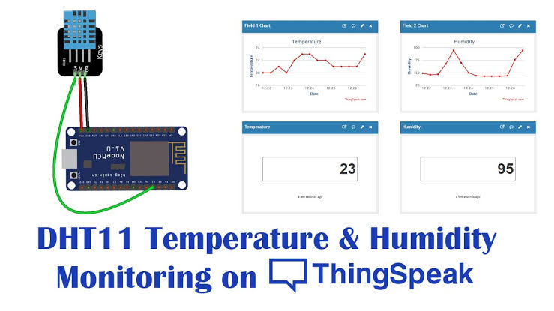
Creating diagrams and schematics to illustrate the deployment of loT devices throughout the park, data flow from devices to the cloud platform, and the architecture of the platform itself. Include screenshots of the user interface, data visualization, and notification system in our documentation.

Slide 9
Block diagram:
Wokwi
Simulator
ESP32
DHT22
Temperature
Humidity
Thing speak
Clouds

Slide 10
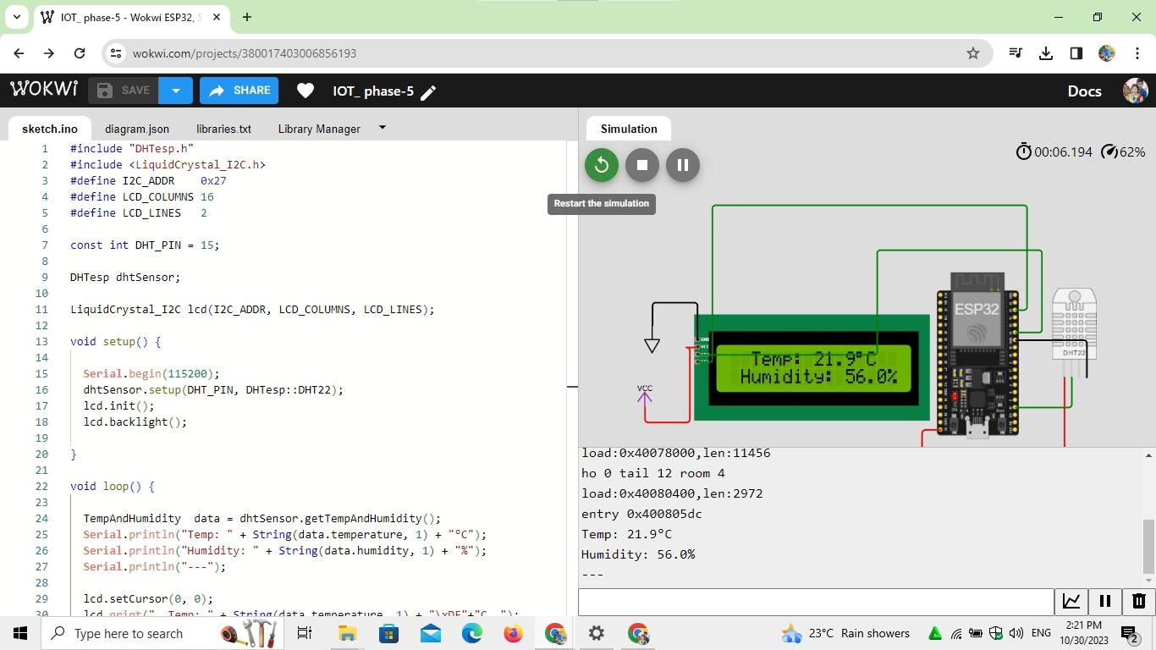

Slide 11
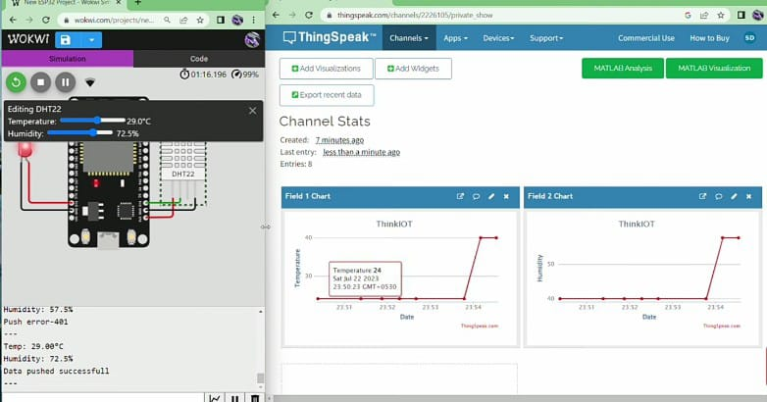

Slide 12
Benefits:
The real-time environmental monitoring system benefits park visitors by:
1. *Enhancing Safety*: Visitors can stay informed about changing weather conditions and air quality, reducing exposure to potential hazards.
2. *Encouraging Outdoor Activities*: Accurate data on conditions like temperature and UV index can motivate visitors to engage in outdoor activities and events.
3. *Educational Opportunities*: The system can be used for educational purposes, teaching visitors about local ecosystems and the impact of environmental changes
.4. *Resource Management*: Park management can make informed decisions regarding staff allocation, maintenance, and emergency response based on real-time data.

Slide 13
**Overall, this project contributes to a safer, more engaging park experience while promoting outdoor activities and environmental awareness.**
CONCLUSION
the creation of a real-time environmental monitoring system for a park is a comprehensive project with a clear set of objectives that benefit both park visitors and park management. By deploying loT devices strategically and developing a robust platform for data collection and analysis, this project aims to ensure visitor safety, encourage outdoor activities, educate visitors about the local ecosystem, and empower park management with data-driven decision-making tools.The successful implementation of this project will depend on careful planning, sustainable deployment of loT devices, robust platform development, and user-friendly interfaces. Additionally, it's essential to prioritize data privacy and security, scalability, and energy efficiency.
Ultimately, the real-time environmental monitoring system will provide park-goers with valuable information about weather conditions, and other relevant data, enhancing their overall park experience. Meanwhile, park management will have the tools they need to allocate resources effectively and respond to emergencies promptly. This project has the potential to make parks safer, more engaging, and environmentally conscious, contributing to a better quality of life for both visitors and the surrounding ecosystem.

